Slide 1
CHAPTER 5
The process
A process is the basic active entity in most operating-system models. This chapter first addresses issues of program layout, command-line arguments, program environment and exit handlers. Then this chapter covers the UNIX process model, including process creation, process destruction and daemon processes.
Prof. Ju-Hong Lee, Data Science Lab, Inha Univ

Slide 2
5.0 Program Layout

Slide 3
main Function(1/3)
Main function’s prototype
Arguments
argc is the number of command-line arguments,
argv is an array of pointers to the arguments.
When a C program is executed by the kernel by one of the exec functions, a special start-up routine is called before the main function is called .
The executable program file specifies this routine as the starting address for the program
This start-up routine takes values from the kernel
command-line arguments
environment and sets
int main(int argc, char *argv[]);
user’s shell
start up code
exit(main(…));
main()
{
…
}
Notes:
프로세스에 대해서 설명하기 전에, 프로그램 실행 시 어떻게 main()가 수행 되어지는지 살펴보자. 즉, main함수로 command-line arguments들과 환경변수들이 어떻게 넘어가고, 메모리 레이아웃이 어떻게 구성되는지 살펴보자.
커널은 main함수를 호출하기 전에 특별한 start-up루틴을 호출한다. 실행프로그램들은 이 start-up루틴을 프로그램의 starting address로서 명시한다. start-up루틴은 커널로 부터 다음과 같은 두 가지 값들을 취한다.
- 명령라인 아규먼트들.
- 환경변수들.

Slide 4
main Function(2/3)
Command-Line Argument
When a program is executed, the process that does the exec can pass command-line arguments to the new program
$ ./echoarg arg1 TEST foo argv[0]: ./echoarg argv[1]: arg1 argv[2]: TEST argv[3]: foo
#include <stdio.h>
int main(int argc, char *argv[])
{
int i;
for (i = 0; i < argc; i++) /* echo all command-line args */
printf("argv[%d]: %s\n", i, argv[i]);
exit(0);
}
Notes:
프로그램을 실행 시 exec를 호출한 프로세스는 명령라인 아규먼트들을 새로운 프로그램으로 넘길 수 있다. 예를 들어 사용자들의 명령을 처리해 주는 쉘은 사용자가 입력한 실행프로그램 뒤에 아규먼트들을 실행프로그램 실행 시 넘겨준다.

Slide 5
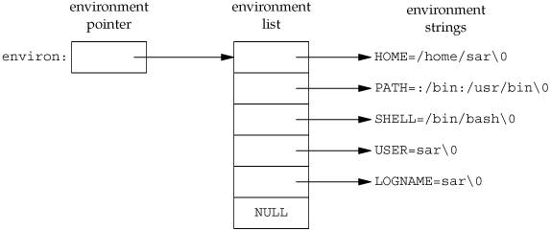
main Function(3/3)
$ env $ echo $HOME (.profile, .login, .cshrc)
Environment List
The environment list is an array of character pointers
Address of the array of pointers is contained in the global variable environ :
Most UNIX system have provided a third argument to the main function
extern char **environ; /* stdlib.h */
for (i = 0; environ[i]; i++) printf(“env[%d]: %s\n", i, environ[i]);
extern char **environ;
Access to specific environment variables is normally through the getenv and putenv functions instead of through the environ variable.
int main(int argc, char *argv[], char *envp[]);
Notes:
환경변수 리스트는 시스템의 환경 변수들을 말한다. 즉, HOME, PATH.. 등등. 시스템 사용에 필요한 정보들을 말한다. 환경변수는 grobal변수로 정의되어 있다. 환경변수들에 접근을 용이하게 하기 위해 getenv와 putenv함수를 제공하고 있다. 윈도우와 달리 대부분의 유닉스 시스템들은 main함수에 세번째 아규먼트를 환경변수로서 제공한다. 즉, 호출 프로세스는 프로그램을 실행하기 전에 실행프로그램의 환경변수를 임의로 지정하는 것이 가능 하다. 환경변수는 다음 파일들에서 설정가능하다 :.profile, .login, .cshrc. 형식은 [변수명: 값]으로 설정한다.

Slide 6
Memory Layout a C Program(1/3)
C Program has been composed of
Text(Code) Segment :
program instructions to be executed (machine instruction)
Initialized data segment :
initialized global and static variables
Uninitialized data segment (bss) :
uninitialized global and static variables.
Data in this segment is initialized by the kernel to arithmetic 0 or null pointers before the program starts executing
Stack :
stores variables that are local to functions
when a functions is called, its automatic variables are allocated on the top of the stack
when it ends its variables are de-allocated
int maxcount = 99
long sum[1000];
Notes:
C프로그램은 크게 4개의 영역(text, global, stack, heap)으로 메모리가 레이아웃된다. 여기서 global영역은 초기화 여부에 따라 initialized data segment와 uninitialized data segment(bss-block started by symbol)로 나뉜다. initialized data segment의 경우 컴파일된 실행모듈의 크기에 포함되지만 uninitialized data segment의 경우 실행모듈의 크기에 포함되지 않는다. uninitialized data segment는 프로그램 실행시 커널에의해 공간이 할당되고 초기화 되어진다.

Slide 7
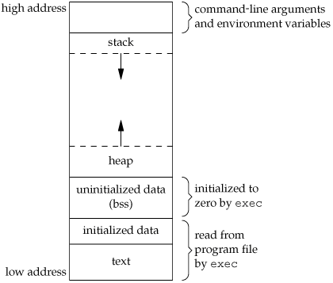
Memory Layout a C Program(2/3)
Heap :
Dynamic memory is allocated from the heap
Contents of the uninitialized data segment are not stored in the program file on disk.
The only portions of the program that need to be saved in the program file are the text segment and the initialized data.
$ size /usr/bin/cc /bin/sh text data bss dec hex filename 79606 1536 916 82058 1408a /usr/bin/cc 619234 21120 18260 658614 a0cb6 /bin/sh
Notes:
fork_memory.c

Slide 8
Memory Layout a C Program(3/3)
/* init.c */
int myarray[50000]={0}; int main(){
return 0;
}
/* noninit.c */
int myarray[50000]; int main(){
return 0;
}
[root@localhost root]# cc noninit.c -o noninit [root@localhost root]# cc init.c -o init [root@localhost root]# ls -l init noninit
-rwxr-xr-x 1 root root 214604 4월 7 17:00 init -rwxr-xr-x 1 root root 14598 4월 7 17:00 noninit
[root@localhost root]# size init noninit text data bss dec hex filename 706 200272 4 200982 31116 init 706 252 200032 200990 3111e noninit
Notes:
학교는 확인 안됨.

Slide 9
5.1 Review of the notation of a process

Slide 10
Process(1/2)
Simply an instance of an executing program.
A process corresponds to an execution of a program
Program ≠ Process
Process incorporate
Program code,
The data values within program variables
Hardware register
Program stack
Process is identified by process id(pid)
The shell create a new process
$ cat file1 file2 $ ls | wc -l
user’s shell
cat
user’s shell
ls
wc
pipe

Slide 11
Process(2/2)
Process environment
Any UNIX process may in turn start other processes.
This gives the UNIX process environment a hierarchical structure paralleling the directory tree of the file system.
At the top of the process tree is a single controlling process, an execution of an extremely important program called init, which is ultimately the ancestor of all system and user processes.
UNIX provide a handful of system call for process creation and manipulation.
fork, exec, wait, exit,…
Notes:
유닉스 프로세스는 다른 프로세스를 시작시킬 수 있다.
이는 프로세스 환경이 디렉토리와 같이 계층적인 구조를 구성하도록 만든다.
최상위에 있는 프로세를 init프로세스라고 하며, 모든 프로세스의 조상이다.

Slide 12
5.2 Creation process

Slide 13
The getpid(2)and getppid(2)system call
process id
Every process has a unique process ID, a non-negative integer.
Although unique, process IDs are reused.
Process id
Every process has a unique process ID, a non-negative integer.
Although unique, process IDs are reused.
#include <unistd.h>
pid_t getpid(void);
Returns: the process ID of the calling process
pid_t getppid(void);
Returns: the parent process ID of the calling process
Notes:
process_id.c

Slide 14
The fork(2) system call(1/4)
#include <unistd.h>
pid_t fork(void);
Returns: 0 in child, process ID of child in parent, -1 on error
Create a new process which is a extract duplicate of the calling process
pid_t pid; …
pid = fork();
parent
fork()
child

Slide 15
The fork(2) system call(2/4)
The child gets a copy of the parent's data space, heap, and stack.
The parent and the child do not share these portions of memory.
The parent and the child share the text segment
We never know whether the child starts executing before the parent or vice versa. This depends on the scheduling algorithm used by the kernel.
Notes:
fork_memory.c

Slide 16
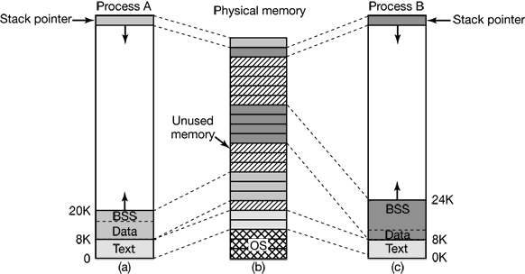
The fork(2) system call(3/4)

Slide 17
The fork(2) system call(4/4)
It is the value of pid that distinguishes child and parent.
In the parent, pid : non-zero (positive), child’s process-id
In the child, pid : 0
Limit error ( EAGAIN )
System-wide limit on the number of processes
Number of processes an individual user
printf (“One\n”);
pid=fork(); printf(“Two\n”);
PC
A
Before
fork()
After
printf (“One\n”); pid=fork();
printf(“Two\n”);
printf (“One\n”); pid=fork();
printf(“Two\n”);
PC
PC
A
B

Slide 18
example p.91 (123)
#include <unistd.h>
main()
{
pid_t pid;
printf (“Just one process so far\n”);
printf (“Calling fork …\n”);
pid = fork();
if (pid == 0)
printf(“I’m the child\n”);
else if (pid > 0)
printf(“I’m the parent, child has pid %d\n”, pid);
else
printf(“Fork returned error code, no child\n”);
}

Slide 19
5.3 Running new program with exec

Slide 20
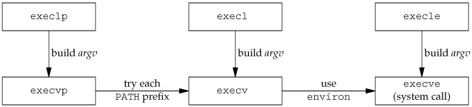
The exec family(1/3)
The exec family can be used to initiate the execution of a new program.
The process ID does not change across an exec, because a new process is not created;
exec merely replaces the current process - its text, data, heap, and stack segment – with a new program from disk.
In many UNIX system implementations, only one of these six functions, execve, is a system call within the kernel.

Slide 21
The exec family(2/3)
int main(int argc, char *argv[]);
#include <unistd.h>
int execl(const char *pathname, const char *arg0,…/*NULL*/ );
int execv(const char *pathname, char *const argv[]);
int execle(const char *pathname, const char *arg0,…/*NULL*/,char *const envp[]);
int execve(const char *pathname, char *const argv[], char *const envp[]);
int execlp(const char *filename, const char *arg0,.../*NULL*/ );
int execvp(const char *filename, char *const argv[]);
All six return: -1 on error, no return on success
It is important to stress that exec does not create a new sub-process to run concurrently with the calling process
The first parameter of exec family must contain a true program or a shell script with execute permission

Slide 22
The exec family(3/3)
The letters in the function names help somewhat.
The letter p means that the function takes a filename argument and uses the PATH environment variable to find the executable file.
The letter l means that the function takes a list of arguments and is mutually exclusive with the letter v, which means that it takes an argv[] vector.
Finally, the letter e means that the function takes an envp[] array instead of using the current environment.
The PATH variable contains a list of directories, called path prefixes, that are separated by colons. For example, the name=value environment string
$ echo $PATH
PATH=/bin:/usr/bin:/usr/local/bin/:.

Slide 23
example p.93 (126)
/* runls -- ls를 수행하기 위해 “execl”을 수행한다 */
#include <unistd.h>
main(){
printf("executing ls\n");
execl("/bin/ls", "ls", "-l", (char *)0);
/* 만일 execl이 복귀하면, 호출은 실패한 것이다. 따라서...*/
perror("execl failed to run ls");
exit(1);
}
printf (…);
execl(“bin/ls”,…);
PC
runls
Before
exec
After
/* ls의 첫 번째 줄 */
PC
ls command

Slide 24
example p.95 (128)
/* runls2 -- ls를 수행하기 위해 execv를 사용한다. p.95 (128) */
#include <unistd.h>
main()
{
char *const av[]={"ls", "-l", (char *)0};
execv("/bin/ls", av);
/* 반복하거니와 여기까지 수행이 진행되면 오류를 의미 */
perror("execv failed");
exit(1);
}

Slide 25
example p.96 (130)
Accessing arguments passed with exec
main() /* p.96 (130)
{
char * const argain[] = {"myecho", "hello", "world", (char *)0};
execvp(argin[0],argin);
}
/* myecho -- 명령줄 인수를 그대로 출력한다 */
main(int argc, char** argv)
{
while( --argc > 0)
printf(“%s ", *++argv);
printf("\n");
}
$ myecho hello world

Slide 26
5.4 Using exec and fork together

Slide 27
example p.97(131) (1/2)
/* runls3 -- 부프로세스에서 ls를 수행한다 */
#include <unistd.h>
int fatal(char *s){
perror(s);
exit(1);
}
main(){
pid_t pid;
switch (pid = fork()){
case -1:
fatal("fork failed");
case 0:
/*자식이 exec을 호출 */
execl("/bin/ls", "ls", "-l", (char*)0);
fatal("exec failed");
break;
default:
/* 부모가 자식이 끝날 때까지 수행이 일시 중단하기 위해 wait을 호출 */
wait((int*)0);
printf("ls completed\n");
exit(0);
}
}

Slide 28
example p.97(131) (2/2)
pid = fork();
PC
A
Before fork
fork
After fork
wait((int *)0);
execl(“/bin/ls”,…);
PC
PC
A
B
exec
After exec
wait((int *)0);
/* 1st line of ls */
PC
PC
A
B

Slide 29
The docommand example p.99
/* docommand --run shell command, first version */
int docommand(char *command)
{
pit_t pid;
if((pid = fork()) < 0 )
return (-1);
if(pid==0) /* child */
{
execl("/bin/sh", "sh", "-c", command, (char *)0);
perror("execl");
exit(1);
}
/* code for parent */
/* wait until child exits */
wait((int *)0);
return(0);
}
The –c argument used in the invocation of the shell tells it to take commands from the next string argument, rather than standard input.

Slide 30
5.5 Inherited data and file descriptors

Slide 31
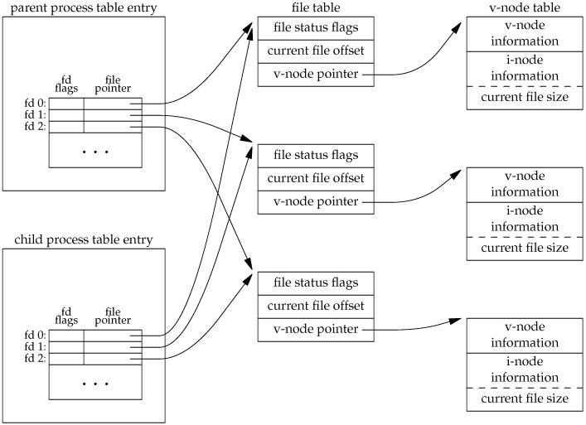
fork, files and data
fork_filedes.c
All the files open in the parent are also open in the child
It is important that the parent and the child share the same file offset
Parent’s offset be updated by the child when the child writes to standard out.
Notes:
fork_filedes.c

Slide 32
example p.101 (136)
/* fork는 "data"가 최소한 20문자 이상임을 가정한다 */
main(){
int fd;
pid_t pid;
char buf[10]; /* 화일 자료를 저장할 버퍼 */
if((fd = open("data", O_RDONLY)) == -1)
fatal("open failed");
read(fd, buf, 10); /*화일 포인터를 전진 */
printpos("Before fork", fd);
switch(pid = fork()) {
case -1: /* 오류 */
fatal("fork failed");
break;
case 0: /* 자식 */
printpos("Child before read", fd);
read(fd, buf, 10);
printpos("Child after read", fd);
break;
default: /* 부모 */
wait((int *)0);
printpos("Parent after wait", fd);
}
}

Slide 33
Inherited properties from parent process
Real user ID, real group ID, effective user ID, effective group ID
Supplementary group IDs
Process group ID
Session ID
Controlling terminal
The set-user-ID and set-group-ID flags
Current working directory
Root directory
File mode creation mask
Signal mask and dispositions
The close-on-exec flag for any open file descriptors
Environment
Attached shared memory segments
Memory mappings
Resource limits
fork(2)

Slide 34
The difference between the parent and child
The return value from fork
The process IDs are different
The two processes have different parent process IDs: the parent process ID of the child is the parent; the parent process ID of the parent doesn't change
The child's tms_utime, tms_stime, tms_cutime, and tms_cstime values are set to 0
File locks set by the parent are not inherited by the child
Pending alarms are cleared for the child
The set of pending signals for the child is set to the empty set
Notes:
clock_t tms_utime; /* 포르세스의 사용자 시간 */
clock_t tms_stime; /* 프로세스의 커널 시간 */
clock_t tms_cutime; /* 자식들의 사용자 시간 */
clock_t tms_cstime; /* 자식들의 커널 시간 */

Slide 35
exec and open files
close_on_exec.c, close_off_exec.c exec.c
File open in the original program are kept open when an entirely new program is started through exec.
Read-writer pointers (file offset) for such files are unchanged by the exec call
If close-on-exec flag is on (the default is off), then the file fragment shows how the close-on-exec flag is enabled
#inlucde <fcntl.h>
.
.
int fd;
fd = open(“file”, O_RDONLY);
.
.
fcntl(fd, F_SETFD, 1); /* close-on-exec 플래그를 on으로 설정 */
fcntl(fd, F_SETFD, 0); /* close-on-exec 플래그를 off으로 설정 */
res = fcntl(fd, F_GETFD, 0); /* res==1:on, res==0:off */
Notes:
close_on_exec.c, close_off_exec.c exec.c

Slide 36
example
int main(int argc, char** argv)
{
int fd;
pid_t pid;
fd = open(“test”, O_RDONLY);
pid = fork();
if(pid == 0){
execl(“exec",“child",0);
}
if(pid<0){
perror("MAIN PROCESS");
}
wait(NULL);
printf("MAIN PROCESS EXIT\n");
close(fd);
return 0;
}
/* exec.c */
int main(int argc, char** argv)
{
if( read(3, buff, 512) < 0){
perror("EXEC PROCESS");
exit(1);
}
printf("EXEC PROCESS EXIT\n”);
return 0;
}

Slide 37
Inherited properties from the calling process
Real user ID and real group ID
Supplementary group IDs
Process group ID
Session ID
Controlling terminal
Time left until alarm clock
Current working directory
Root directory
File mode creation mask
File locks
Process signal mask
Pending signals
Resource limits
Values for tms_utime, tms_stime, tms_cutime, and tms_cstime
exec(2)

